Slide 1
Basics of Data Dog
Presented by
Abilash S R
absomasundaram@deloitte.com

Slide 2
Introduction to Datadog: (Monitoring as a Service)
What is Datadog?
Datadog is a cloud-based monitoring and analytics platform that provides real-time insights into complex IT environments.
It helps organizations of all sizes to monitor their infrastructure, applications, logs, and other data sources in a unified manner, enabling them to identify and resolve issues before they impact their customers quickly
It comes under Software as a Service
Data Dog is an Agent tool also using apis calls
Notes:
IaC evolved to solve the problem of environment drift in release pipelines. Without IaC, teams must maintain deployment environment settings individually.
With IaC, configuration files are created that contain infrastructure specifications, which makes it easier to edit and distribute configurations
Immutable/mutable infrastructure
Declarative/imperative approach

Slide 3
Why is monitoring important?
Monitoring is a critical process in any organization or project. Let me share few reasons why monitoring and evaluation (M&E) play a vital role
Transparency and Accountability
Early Problem Detection
Efficient Resource Utilization
Informed Decision-Making
Learning from Mistakes

Slide 4
Understanding metrics and their significance in data dog
What Are Metrics?
Metrics are quantitative measurements that provide insights into the behavior of a system, application, or service.
They help us understand how various components are performing and whether they meet desired thresholds.
Types of Metrics ?
Performance Metrics: These gauge the efficiency and responsiveness of your system. Examples include response time, throughput, and error rates.
Resource Metrics: These track resource utilization (CPU, memory, disk space) to ensure optimal performance.
Business Metrics: These tie directly to business goals, such as conversion rates, revenue, or user engagement.
Significance of Metrics:
Early Detection: Metrics act as an early warning system. Unusual spikes or drops can indicate issues.
Capacity Planning: Metrics help allocate resources effectively. For instance, monitoring memory usage helps prevent out-of-memory errors.
Trend Analysis: By tracking metrics over time, you can identify patterns and make informed decisions.
Alerting: Set up alerts based on specific metric thresholds to proactively address problems.
Root Cause Analysis: When an incident occurs, metrics guide investigations by pinpointing problematic areas.

Slide 5
Let’s explore the key features of Datadog:
Comprehensive Visibility Across Systems, Apps, and Services:
Datadog seamlessly aggregates metrics and events across the full DevOps stack.
It integrates with various components, including SaaS and cloud providers, automation tools, monitoring and instrumentation, source control, bug tracking, and databases.
Application Performance Monitoring (APM):
Monitor, troubleshoot, and optimize application performance.
Trace requests end-to-end across distributed systems.
Graph and alert on error rates or latency percentiles (p95, p99, etc.).
Instrument your code using open-source tracing libraries.
Log Management:
Analyze and explore log data in context.
Automatically collect logs from services, applications, and platforms.
Seamlessly navigate between logs, metrics, and request traces.
Visualize and set alerts based on log data.
Proactive User Experience Monitoring:
Monitor critical user journeys with an easy-to-use web recorder.
Detect and alert on performance issues for users in various locations.
Manage SLAs and SLOs.

Slide 6
Continue..
Correlate Frontend Performance with Business Impact:
Prioritize decisions with user experience metrics.
Visualize load times, frontend errors, and resources for every user session.
Troubleshoot quickly with frontend, backend, and business metrics in one view1.
Visualize Traffic Flow in Cloud-Native Environments:
Understand performance using meaningful, human-readable tags.
Filter traffic by source and destination.
Report key metrics such as traffic volume and TCP retransmits.
Build Real-Time Interactive Dashboards:
Datadog offers high-resolution metrics and events for manipulation and graphing.
Slice data by host, device, or any other tag.
Customize views interactively or in code.
Collaboration and Alerts:
Discuss issues in context with production data.
Snapshot potential issues and notify your team.
Keep track of responses to alerts and actions taken

Slide 7
Integration Options in data dog
Certainly! Datadog provides more than 700 built-in integrations that allow you to monitor and analyze various systems, applications, and services. Here are some of the integration categories and examples:
Cloud Providers:
AWS: Monitor AWS resources, services, and Lambda functions.
Microsoft Azure: Track Azure services, VMs, and databases.
Containers and Orchestration:
Kubernetes: Monitor Kubernetes clusters, pods, and deployments.
Docker: Collect metrics from Docker containers.
Databases and Data Stores:
Amazon RDS: Monitor Amazon RDS instances and databases.
Microsoft Azure Cosmos DB: Track performance and usage.
Developer Tools and Languages:
GitHub: Monitor repositories and track commits.
Python: Collect Python application metrics.
Networking and Security:
AWS VPC: Monitor network traffic and security groups.
SNMP: Collect SNMP data from network devices.
Messaging and Queues:
Amazon SQS: Monitor message queues.
Apache Kafka: Track Kafka topics and brokers.
Web Services and APIs:
Amazon S3: Monitor S3 buckets and objects.
Google Cloud: Collect metrics from GCP services.

Slide 8
Companies Using Datadog:
Apache
Citrix
Coursera
Free bird Inc.
Mesosphere
Zendesk, and many others.

Slide 9
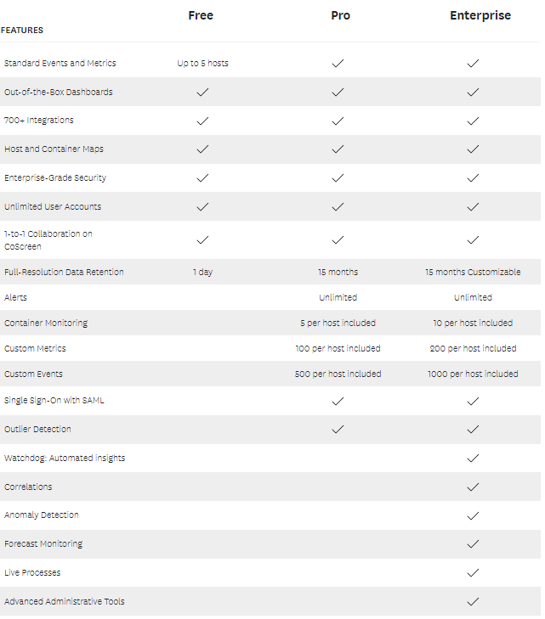
DD Pricing : Data Dog datacenter/Sites available in 6 regions Data Dog mobile application also available for iOS and android Trail period valid for 14 days for up to 5 hosts

Slide 10
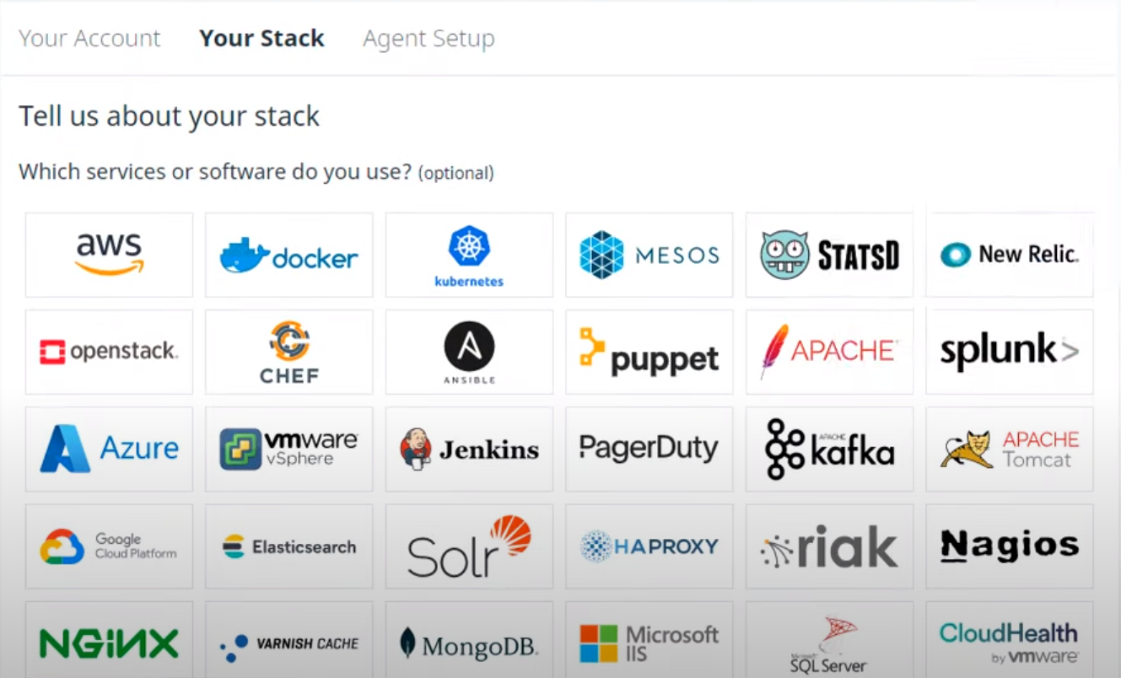
Data Dog initial Setup and adding agents
Step-1 : Create an account in Datadog
Datadog: Log In (datadoghq.com)
Step -2 :Select a service if you have any or just scroll down and select Next

Slide 11
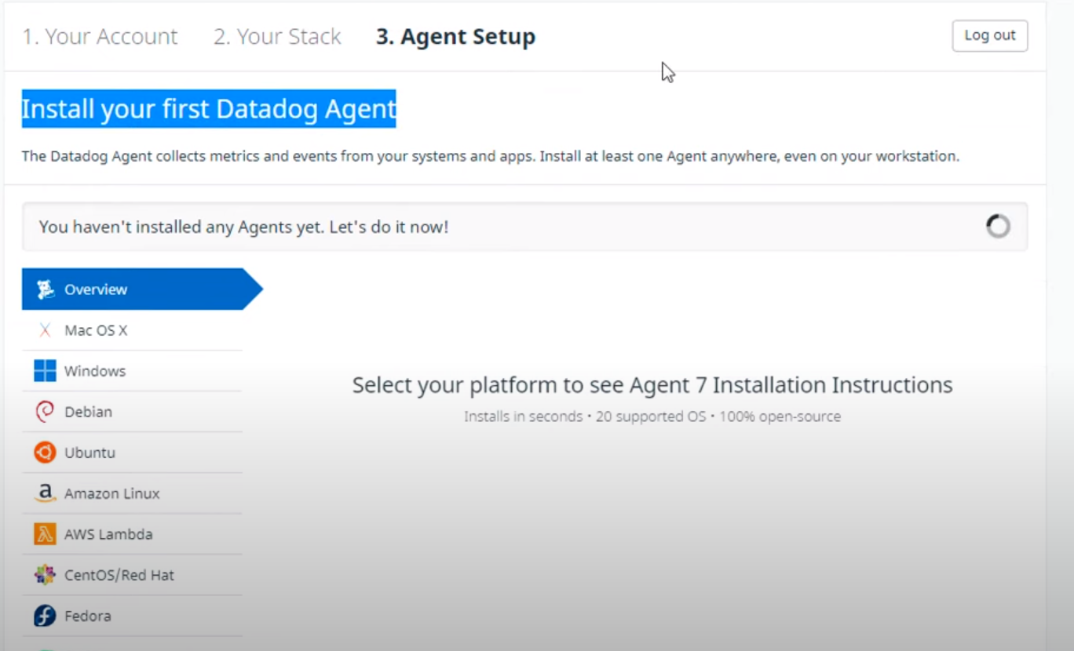
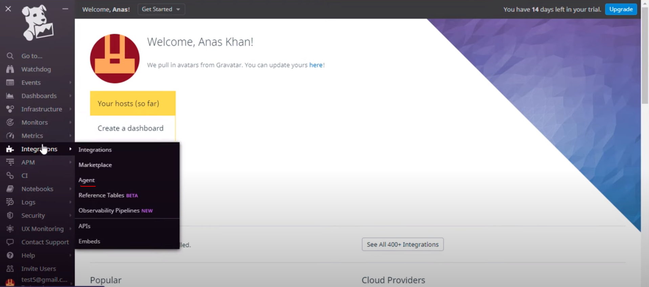
Step -3 : Install your agent or just follow the second snip for agent installation

Slide 12
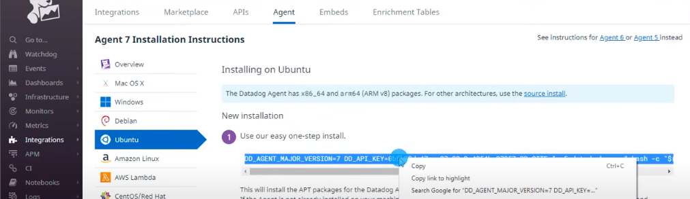
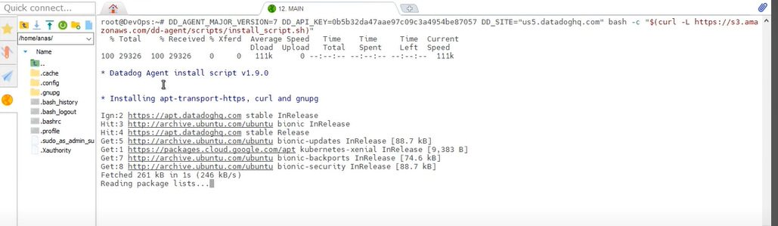
Step -4 :In my case I’m installing DD agent on ubuntu (Just copy and paste the apt package link on the server you want to monitor via DD )

Slide 13
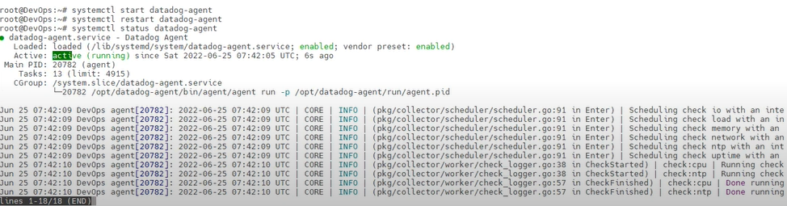
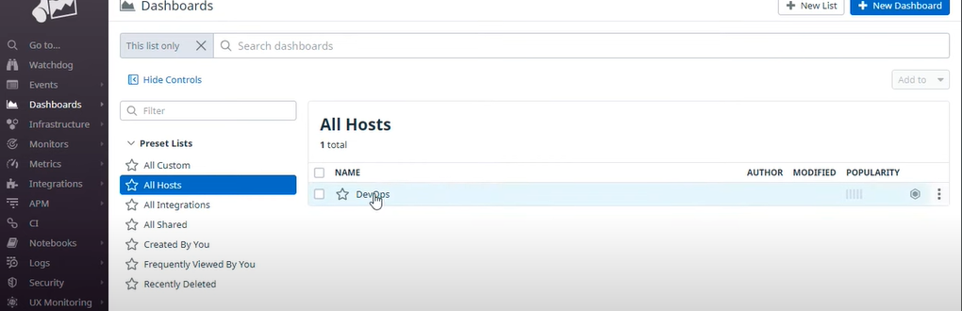
Step -5 :After installing agent just restart and start the service the hosts will be added in the DD console

Slide 14
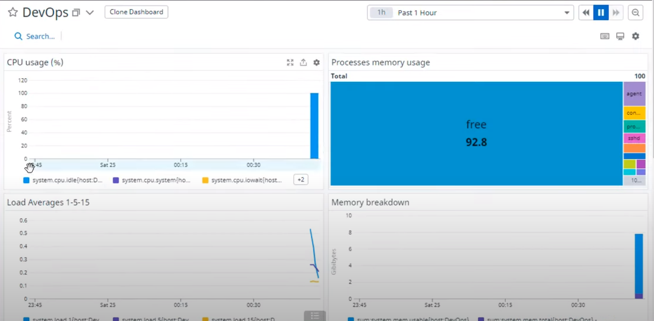
Step -6 :Click on the host name and now see the system utilization in the data dog console

Slide 15
Real-time examples in the DD console.

Slide 16
Thank You ☺

